Slide 1
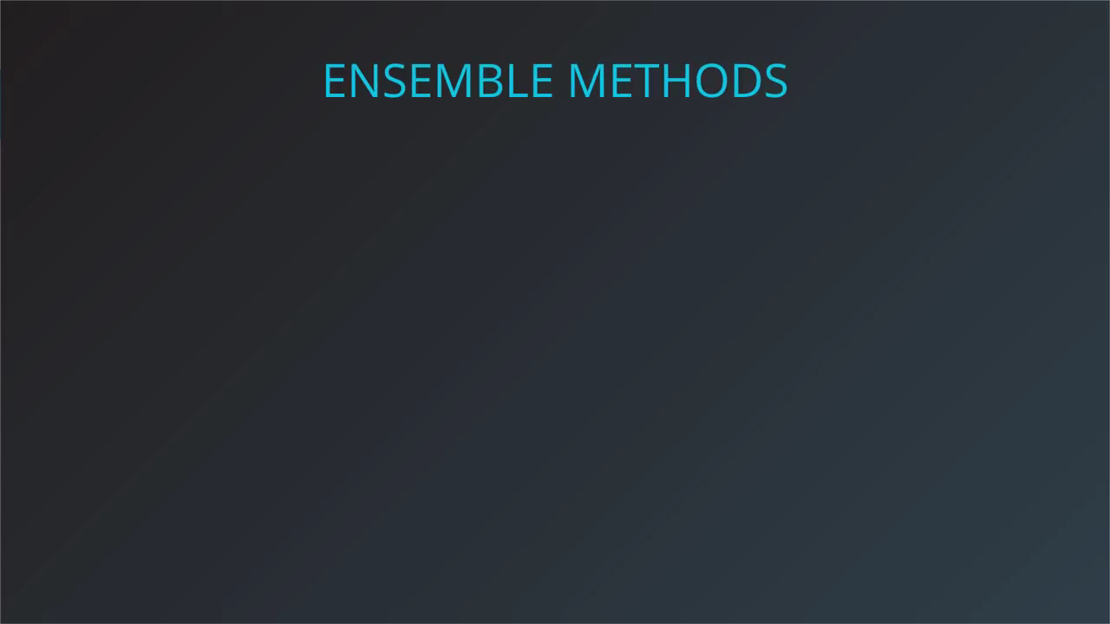
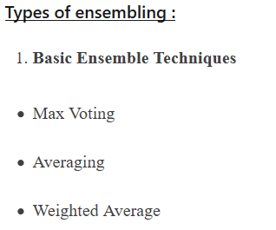
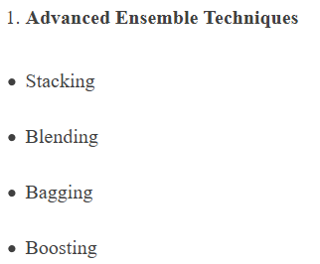

Slide 2


Slide 3
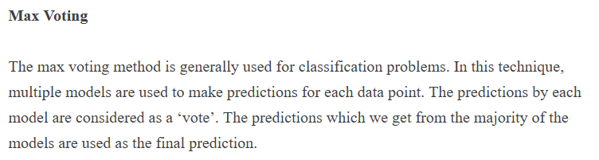
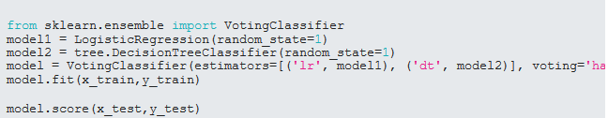

Slide 4
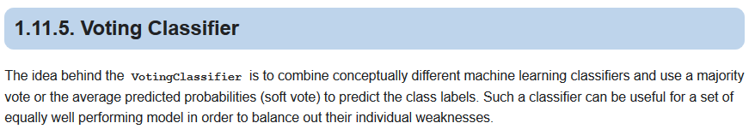
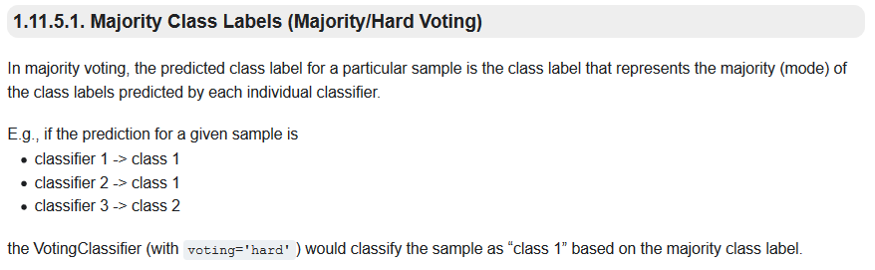
Voting between Algorithms
Hard Voting
Notes:
https://scikit-learn.org/stable/modules/ensemble.html#gradient-boosting

Slide 5
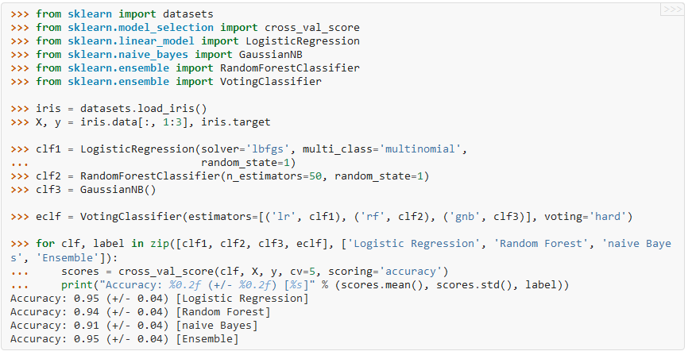

Slide 6
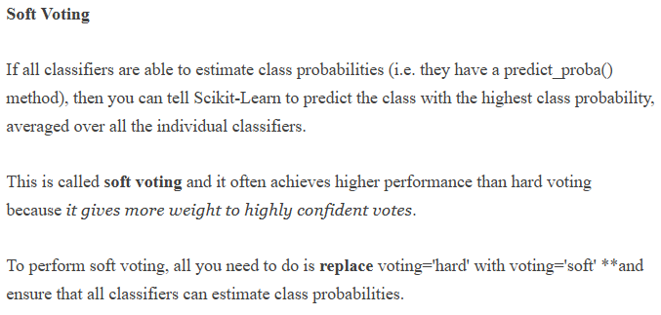
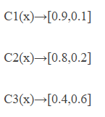
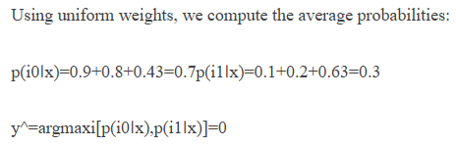
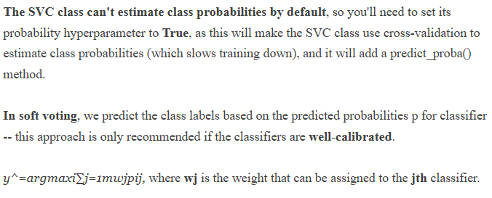
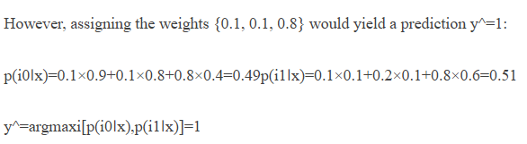

Slide 7
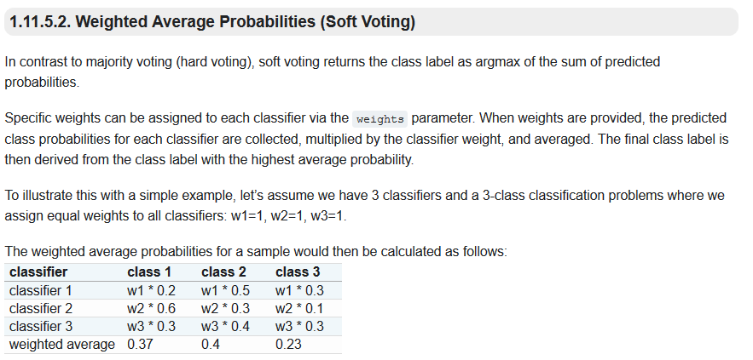

Slide 8
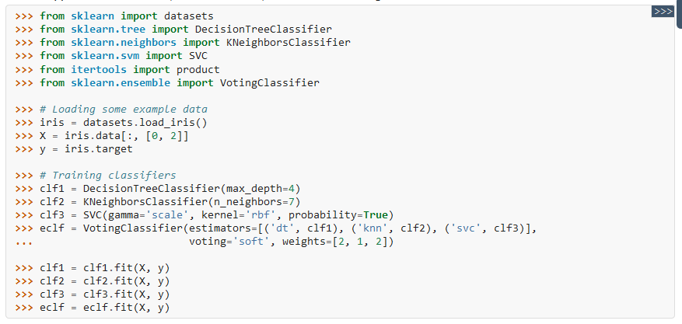
Soft Voting
Notes:
https://scikit-learn.org/stable/modules/ensemble.html#gradient-boosting

Slide 9
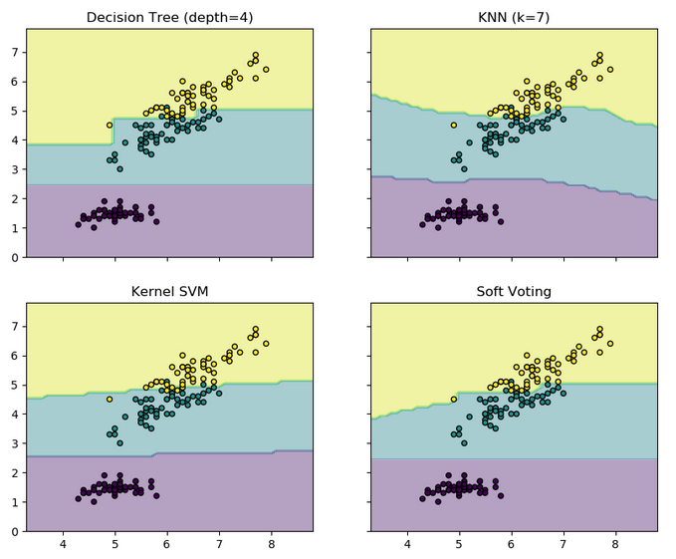
Notes:
https://scikit-learn.org/stable/auto_examples/ensemble/plot_voting_decision_regions.html#sphx-glr-auto-examples-ensemble-plot-voting-decision-regions-py

Slide 10
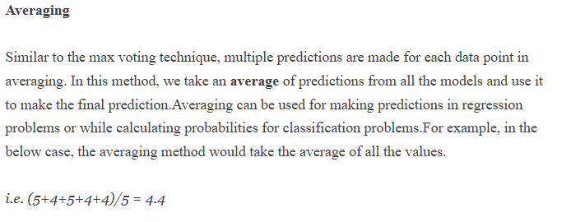
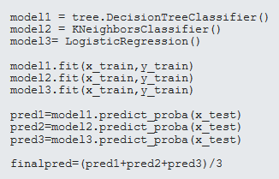

Slide 11
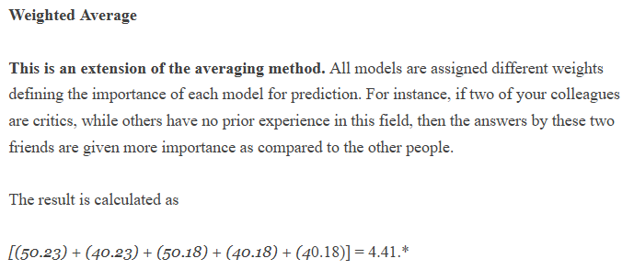
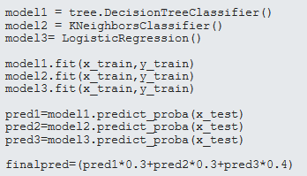

Slide 12
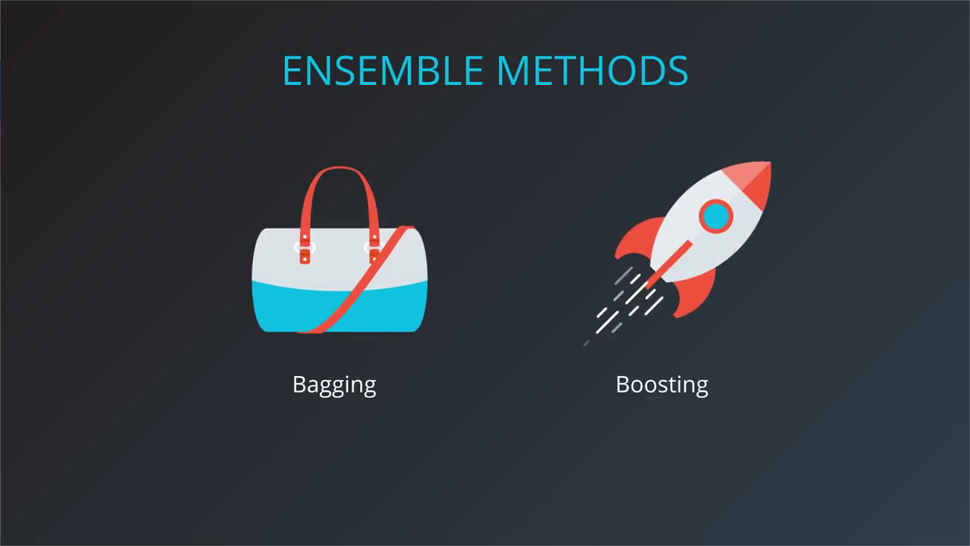

Slide 13
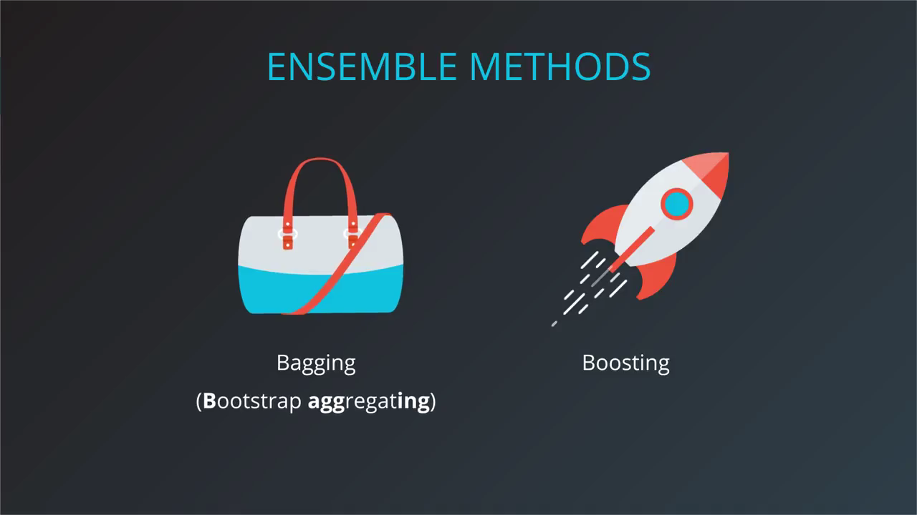

Slide 14
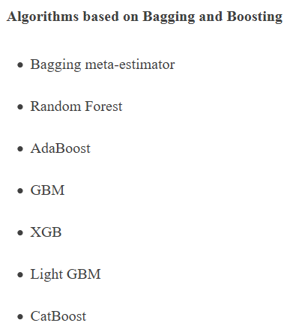

Slide 15
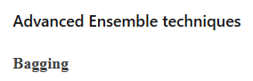
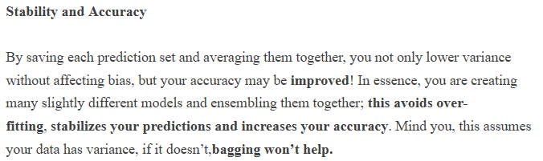
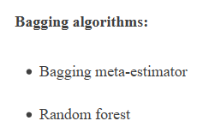
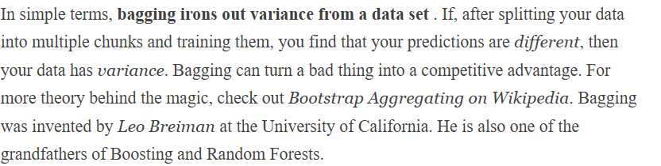
Notes:
https://www.linkedin.com/pulse/ensembling-leacture1-amr-mahmoud/

Slide 16
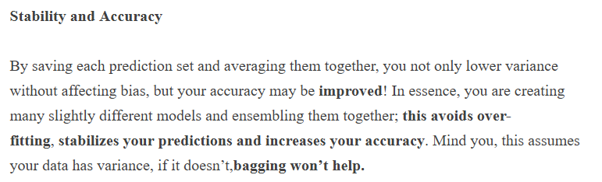
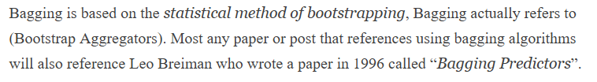
Bagging Advantages

Slide 17
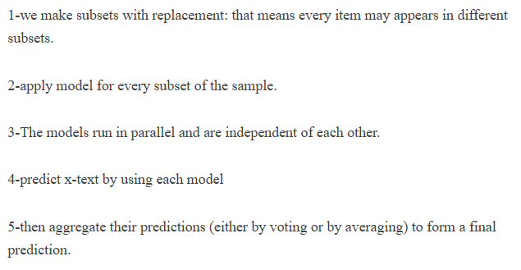
Bagging Algorithm

Slide 18
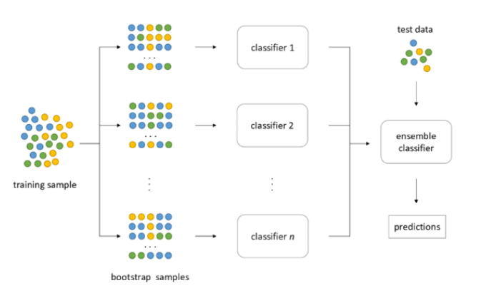

Slide 19
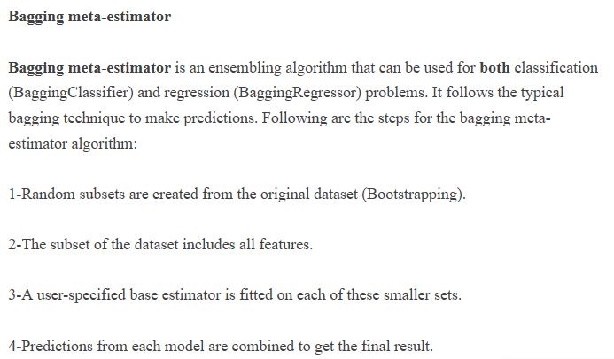
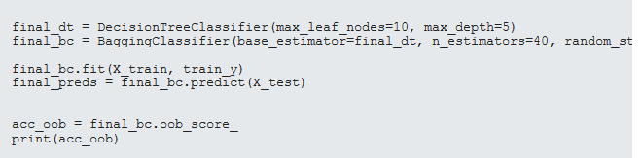

Slide 20
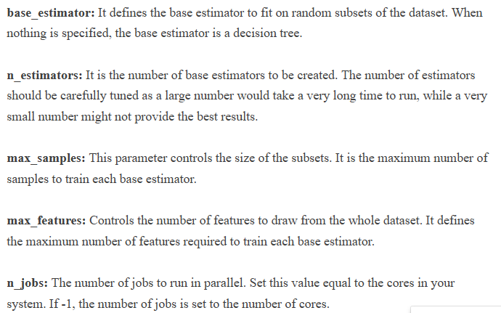

Slide 21
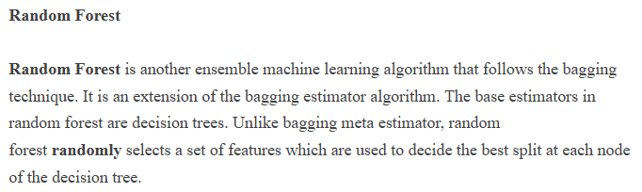
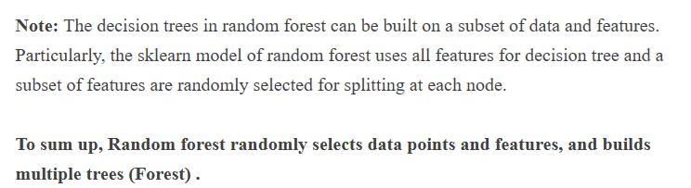

Slide 22
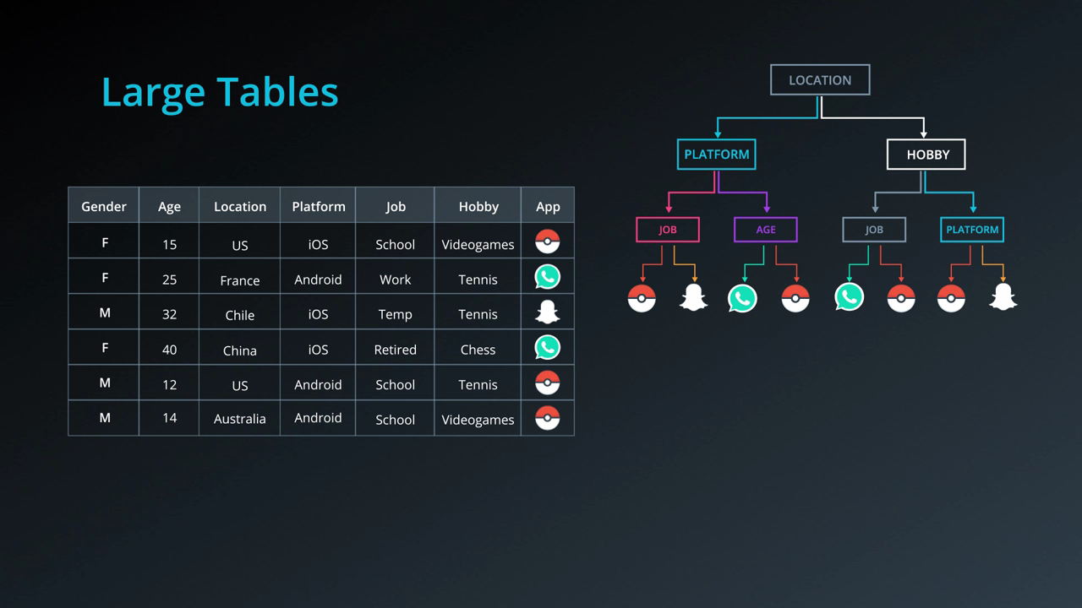

Slide 23
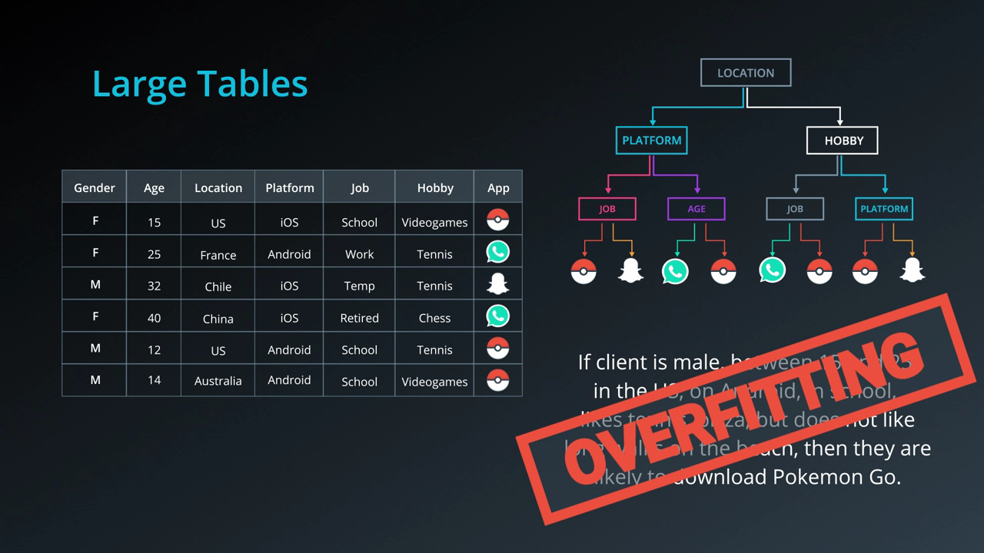

Slide 24
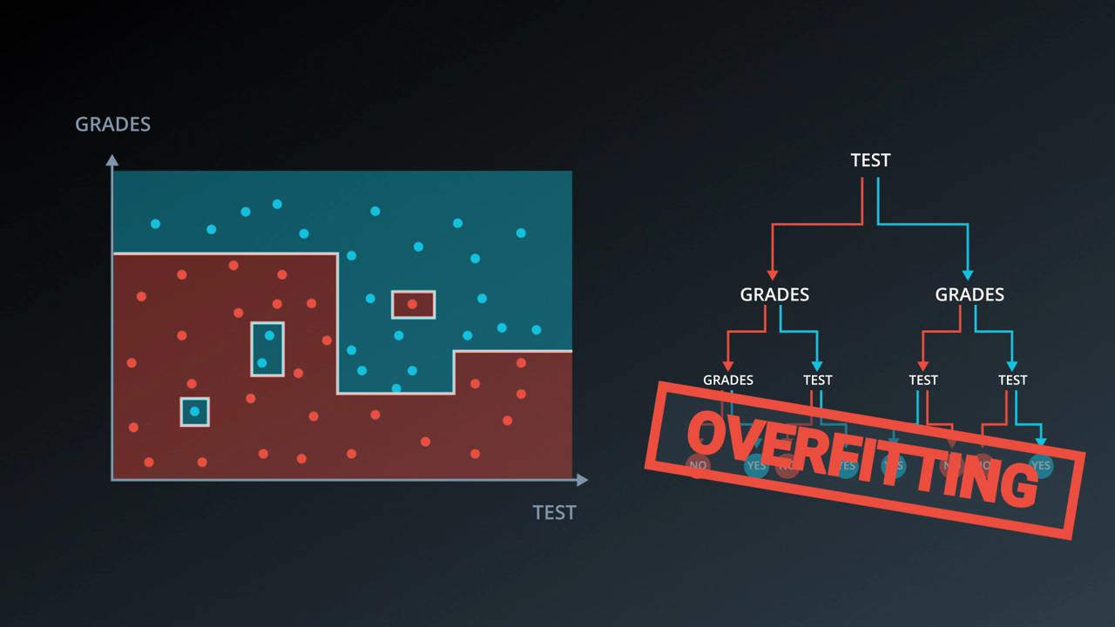

Slide 25
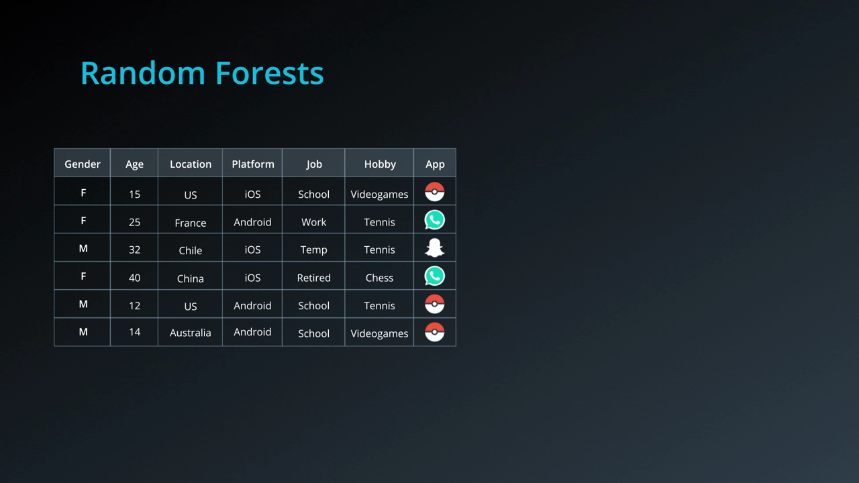

Slide 26
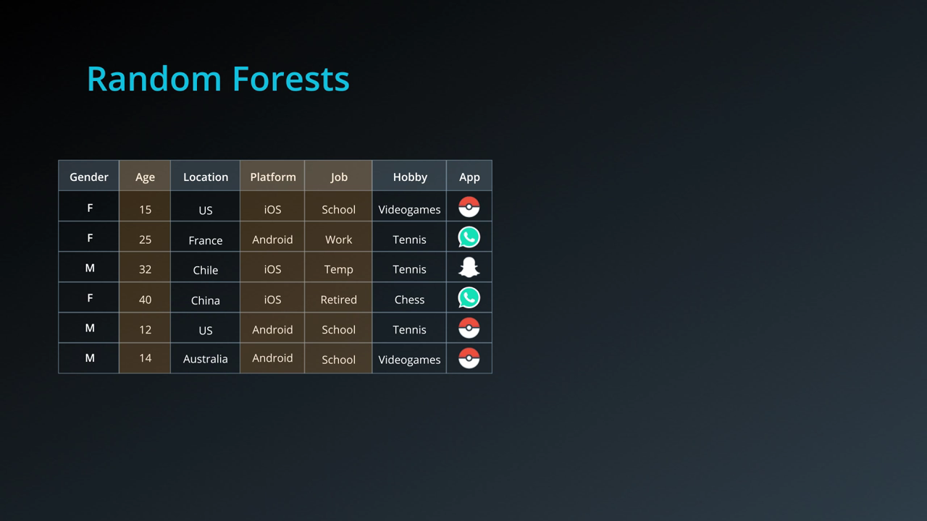

Slide 27
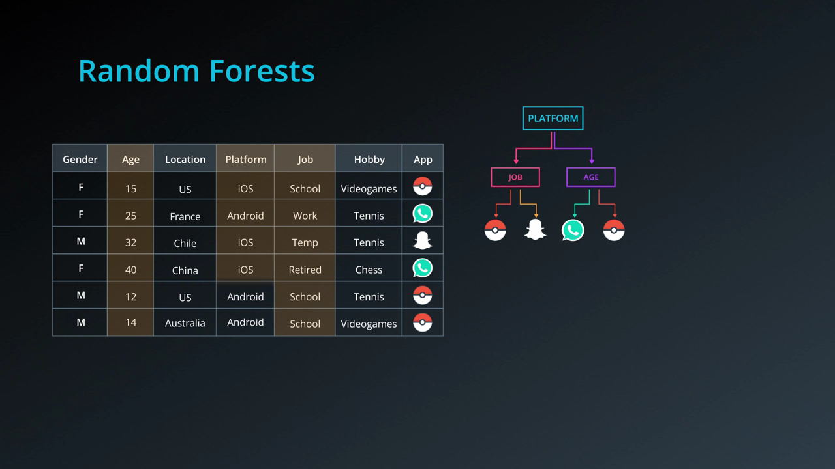

Slide 28
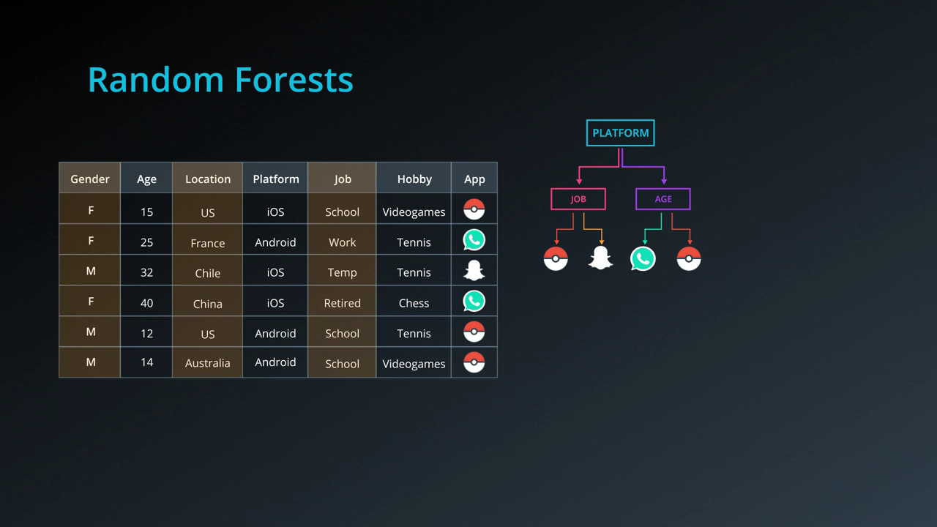

Slide 29
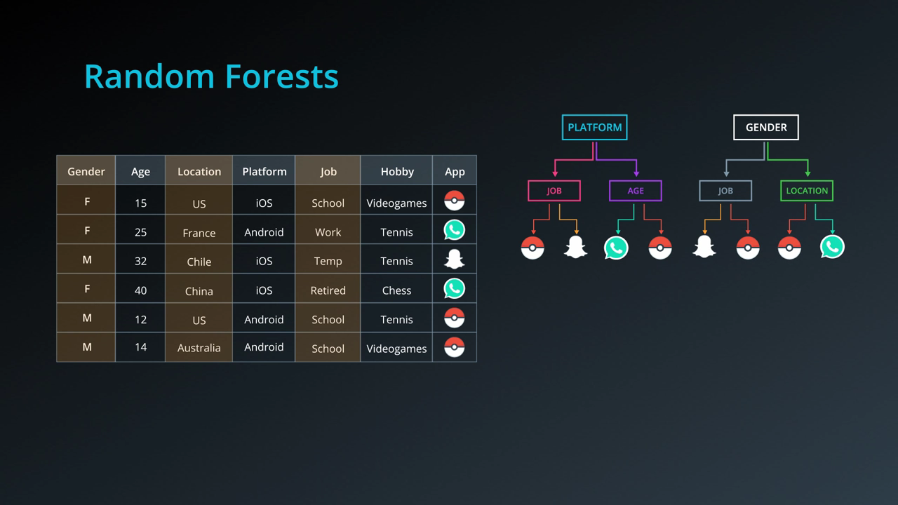

Slide 30
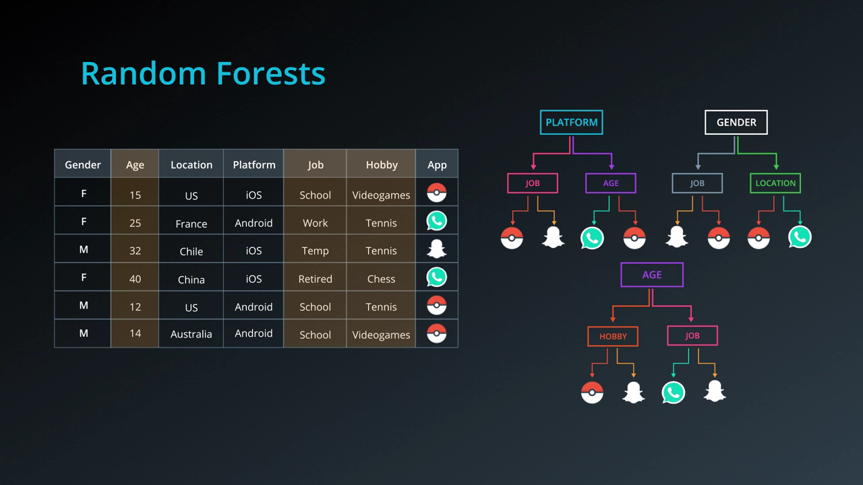

Slide 31
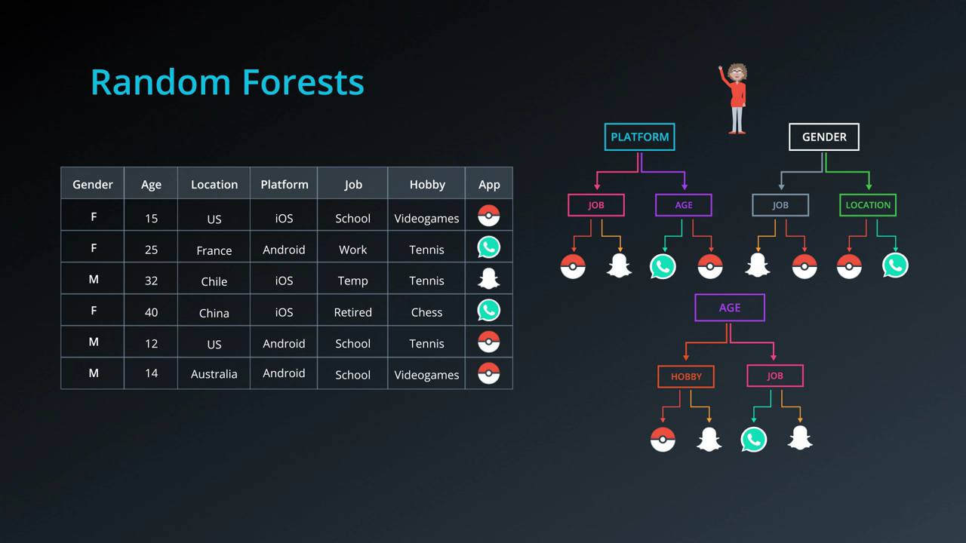

Slide 32
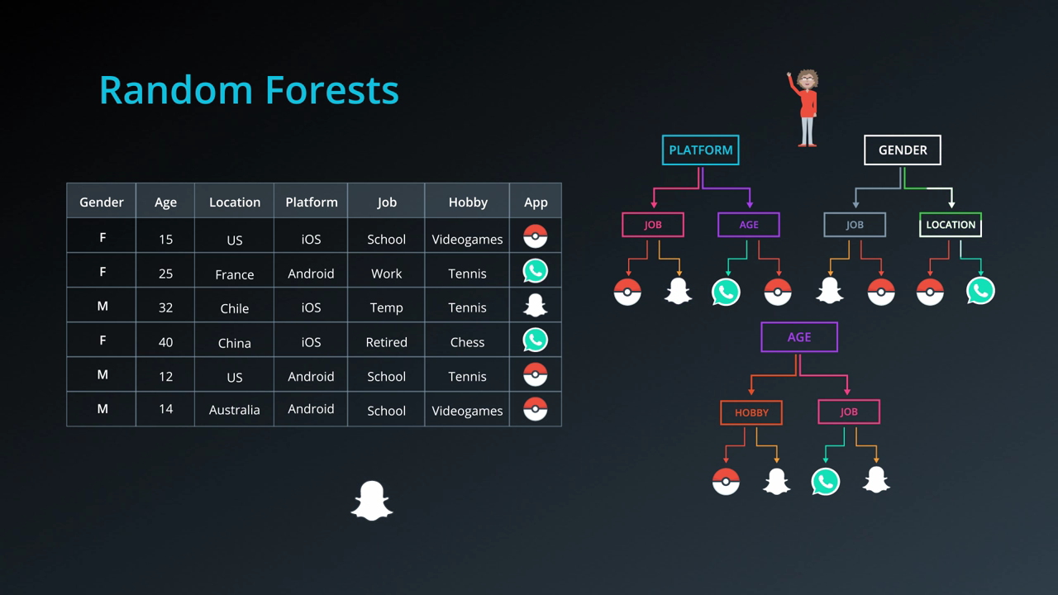

Slide 33
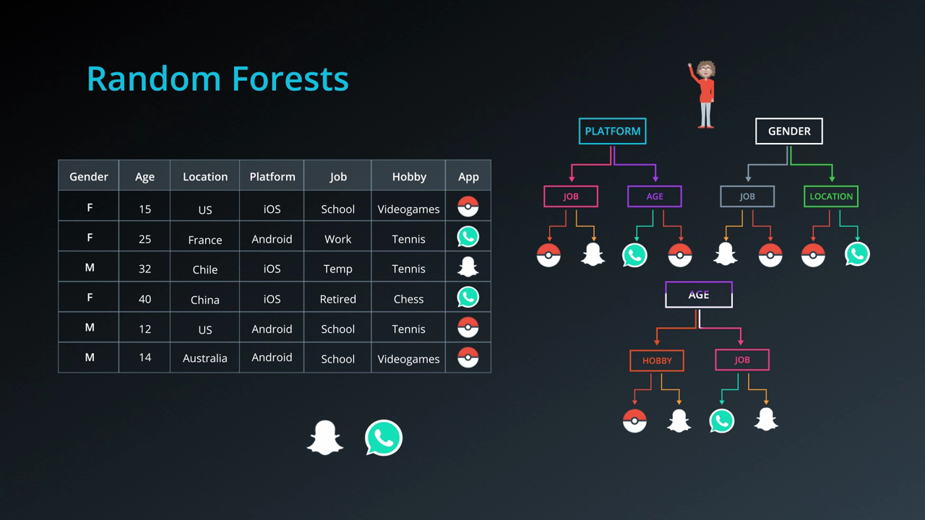

Slide 34
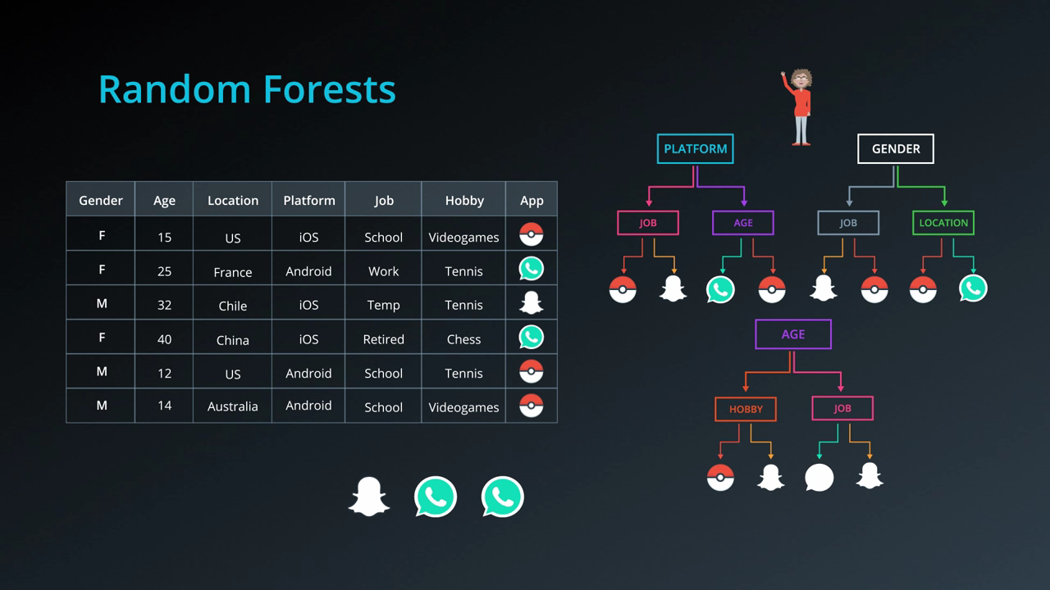

Slide 35
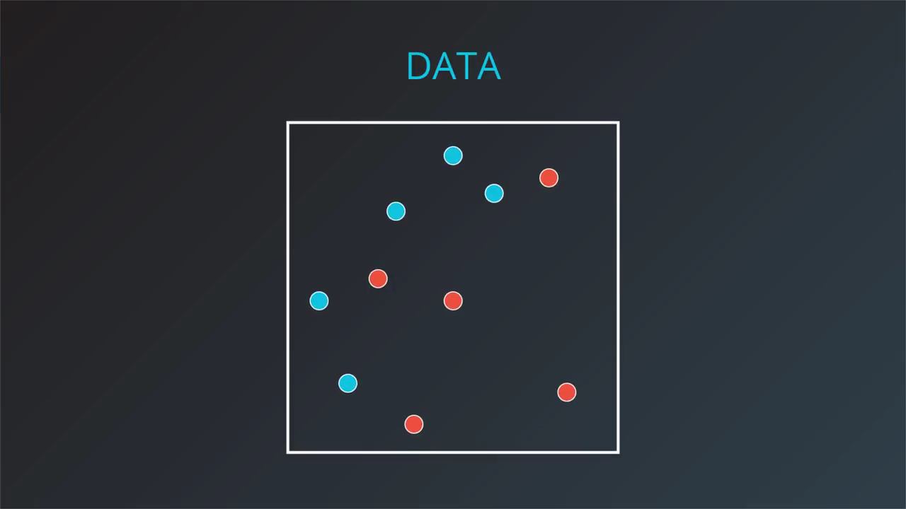

Slide 36


Slide 37


Slide 38


Slide 39


Slide 40


Slide 41


Slide 42


Slide 43


Slide 44


Slide 45

Random Forest Algorithm

Slide 46



Slide 47



Slide 48



Slide 49


Slide 50



Slide 51


Slide 52

Remember this model for later
We fit our first learner in order to maximize accuracy, or minimize the number of errors.

Slide 53

The next weak learner needs to focus on these big points more.
take the misclassified points, and make them bigger.
we'll punish the model more if it misses these points.

Slide 54

Our second weak learner will be this one, which correctly classifies these points.

Slide 55

We'll remember this one for later.

Slide 56

Again, we punish the points that are misclassified by this one, by enlarging these points over here.

Slide 57

Our boosting model will go more until it finish the number of estimators. But we will stop here.
We'll remember this one for later.

Slide 58

Now, we want to combine these models
(We will talk about combination later)

Slide 59

To get this one at end.

Slide 60

And here is the big picture

Slide 61

But how we can enlarge the errors?

Slide 62

By starting to give all points weights = 1

Slide 63

Now run the first weak learner

Slide 64

Calc the correct and incorrect points

Slide 65

Pick the error points and change there weights

Slide 66

The new weight = #correct / #incorrect = 7/3 = 2.33

Slide 67

Now the sum of correct will = the sum of incorrect

Slide 68

By changing the weight the next weak learner will focus on the incorrect with big weights and generates a new
Split despite the small tow errors in the below section.

Slide 69

Sum = 11
Count again the correct and incorrect

Slide 70


Slide 71

11/3 = 3.66

Slide 72


Slide 73


Slide 74


Slide 75


Slide 76

How to combine this three weak learners?

Slide 77

Suppose I have three weak learners like this, which one is the worst?

Slide 78


Slide 79


Slide 80


Slide 81


Slide 82


Slide 83


Slide 84


Slide 85


Slide 86


Slide 87


Slide 88


Slide 89


Slide 90


Slide 91

-ve means that we will listen to the model
but we will take the inverse action

Slide 92

No mistakes
fully mistakes

Slide 93

W =
W =
It rarely appears but if so, we will take one of them and neglect the other weak learners

Slide 94


Slide 95


Slide 96


Slide 97


Slide 98


Slide 99


Slide 100


Slide 101


Slide 102


Slide 103


Slide 104


Slide 105


Slide 106


Slide 107


Slide 108




Slide 109



Notes:
https://scikit-learn.org/stable/auto_examples/ensemble/plot_adaboost_twoclass.html#sphx-glr-auto-examples-ensemble-plot-adaboost-twoclass-py

Slide 110


Notes:
https://scikit-learn.org/stable/modules/ensemble.html#adaboost

Slide 111



Slide 112

Notes:
https://machinelearningmastery.com/stacking-ensemble-for-deep-learning-neural-networks/

Slide 113



Slide 114



Slide 115




